Slide 1

VGreen: Dynamically Powering Data Centers with Renewable Energy
Borathon 2019
Hack Everywhere
June 26-28
Team Rocket
Aubro Sengupta, NSBU – NSX, Intern
Andre Chen, NSBU, – NSX, Intern
Kevin Li, NSBU – NSX, Intern
James Kim, NSBU – NSX, Intern
Dan Kwon, NSBU - NSX, Sr. Product Designer
June 28th 2019

Slide 2
Team Members
# | Members | Role/Title | BU | Location | Tenure
1 | Aubhro Sengupta | Intern | NSBU - NSX | Palo Alto, CA | 1 month
2 | Andrew Chen | Intern | NSBU - NSX | Palo Alto, CA | 1 month
3 | Kevin Li | Intern | NSBU - NSX | Palo Alto, CA | 1 month
4 | James Kim | Intern | VCPP | Palo Alto, CA | 1 month
5 | Dan Kwon | Sr. Product Designer | NSBU - NSX | Palo Alto, CA | 4 months
6 | Bright Tzeng | Enthusiastic Barista | NSBU – NSX | Palo Alto, CA | 2 months
7

Slide 3
Key Information
What is your big idea?
  Data centers today emit as much carbon dioxide as the airline industry and by 2025 the information and communications technology sector around the world could consume 20% of the worlds power.
  Our Borathon big idea visually represents energy sources and emissions of data centers and allows companies to dynamically reallocate power from polluting sources to renewables.
Did you work on your big idea before the Borathon? If yes, please provide some details:
  Brainstormed ideas and previewed some documentation and APIs for potential tools to use for the project.
What will be the expected impact of your idea?
  The US alone used over 70 billion Kwh to power data centers. A 1% reallocation of power from coal to renewables would remove approx. 1 million tones of C02 emissions annually or the equivalent for removing over 200,000 cars.
  Sustainability Impact - Dynamically and seamlessly reallocating to renewable power sources for data centers, helping to reduce their carbon footprint.
  Social Impact – Consumers are ever more looking for companies and brands that have sustainability and environmental stewardship as a pillar. 66% of respondents from of a Nielsen study say they would be willing to pay more for a product or service that had a positive environmental impact. Our service would give companies opportunities to address their impact on the environment to consumers.

Slide 4
Key Information (Borathon Specifics)
What did you implement during this Borathon (48Hr hacking)?
  Created Node frontend visualization with Axios and React (live interactive globe and charts using WebGL and react-vis)
  Wrote Python script to triangulate power usage from nearby power centers and estimate carbon footprint
  Initialized MySQL database on AWS and created schemas for tables to store in database
  Wrote a connector API with MySQL queries
  Searched and scraped viable datasets for use in our project, parsed and formatted to insert into database
  Used Google Maps Geocode API to fetch power plant latitude and longitude from name of plant
  Built a circuit to poll voltage, current, and power data from a mini solar panel to an Arduino
  Setup an ethernet connection between the Arduino and a desktop to send solar panel data
  Wrote a Python script to use sockets to poll Arduino data sent over UDP ethernet and insert data to the MySQL database connected to the frontend
What tools did you use for this Borathon?
  Python3 backend, Node frontend (React with external libraries), MySQL Database hosted on AWS RDS, Arduino hardware and Arduino C (architecture diagram on next slide)
What is the main learning you want to share (if any)
  We tweaked the output of the solar panel in the database to represent worldwide renewable output in order to see significant impact on the carbon footprint of a nearby data center

Slide 5
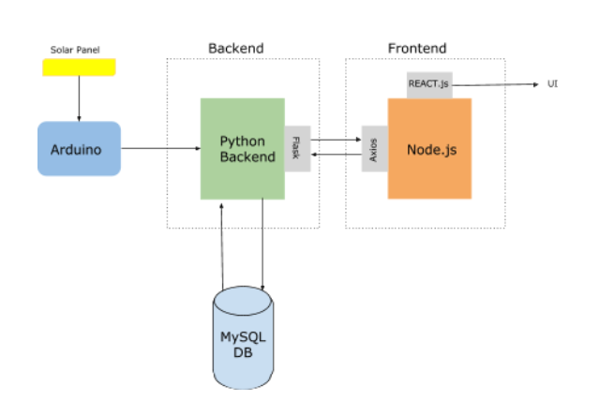
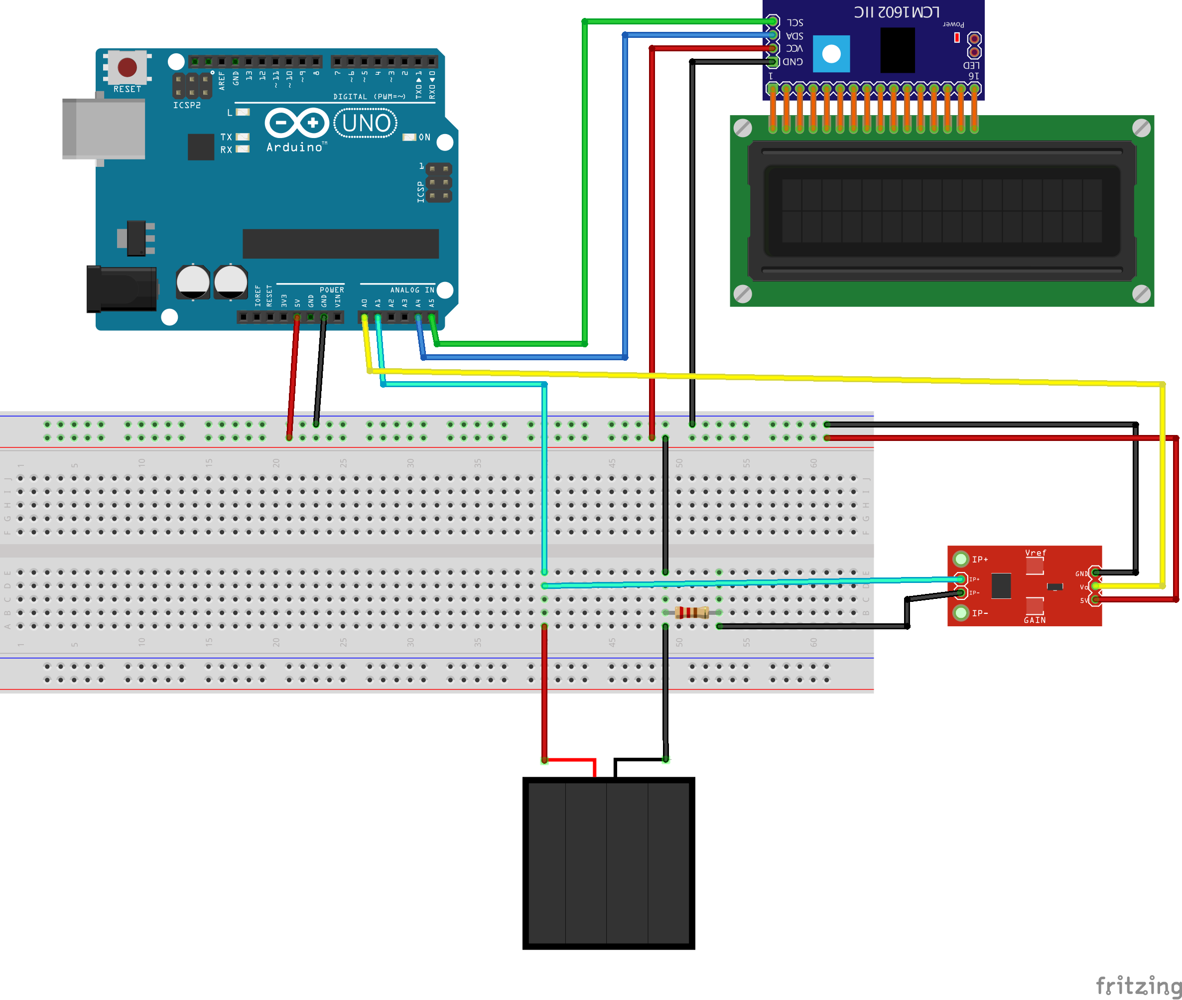
Key Information
Project Architecture
Hardware Schematic

Slide 6
Dashboard

Slide 7
DEMO
(insert link)

